Slide 1
Key Driver Analysis on IMDb Movie Reviews Dataset
By:
VIVEK VIJAY

Slide 2
SUMMARY
This Problem aims to analyze and visualize the importance and sentiment of keywords extracted from customer reviews. The goal is to identify the most influential factors impacting satisfaction scores or sentiment ratings, facilitating targeted improvements in customer experience management.

Slide 3
OBJECTIVES
Use advanced Natural Language Processing (NLP) techniques to identify the most frequently mentioned keywords in customer review.
Conduct sentiment analysis to determine the polarity (positive, negative) associated with each key factor, aiming to understand customers' feelings about these factors.
Quantify the significance of each factor by evaluating its frequency and importance scores within the dataset, to prioritize the most critical factors.
Provide actionable insights for businesses to prioritize customer experience improvements, effectively enhancing satisfaction scores or sentiment ratings.
Present the results visually using scatter plots .

Slide 4
METHODOLOGY
Keyword Extraction
Data Preprocessing
Calculate Combined Importance
Sentiment Analysis
Actionable Insights
Visual Representation
Figure 1. Implementation Block Diagram

Slide 5
Data Preprocessing:
Import necessary libraries .
Define a data preprocessing class to clean, tokenize, and lemmatize text.
Load customer review data from a CSV file.
Apply the preprocessing function to clean the review text.

Slide 6
Keyword Extraction
Initialize CountVectorizer
Load and Fit Data
Calculate Frequencies
Sort and Save Keywords

Slide 7
Sentiment Analysis
Utilize a pre-trained sentiment analysis model to analyze the sentiment of the extracted keywords.
Assign sentiment scores to each keyword based on the analysis.
Aggregate sentiment scores to understand overall customer sentiment.
Combine sentiment scores with keyword importance to enhance insights.

Slide 8
Calculate Importance
Compute TF-IDF scores for each keyword.
Combine frequency and TF-IDF scores to create an overall importance score.
Rank keywords based on the combined importance score to identify critical factors.

Slide 9
Actionable Insights
Interpret the combined importance and sentiment scores of each keyword.
Generate specific recommendations based on the sentiment and importance of each keyword.
Categorize insights into positive and negative.
Prioritize actions to address key factors impacting customer satisfaction.

Slide 10
Visual Representation
Create scatter plots with sentiment polarity on the X-axis and importance score on the Y-axis.
Use different colors and markers to represent sentiment categories.
Annotate scatter plot points with keywords for clarity.

Slide 11
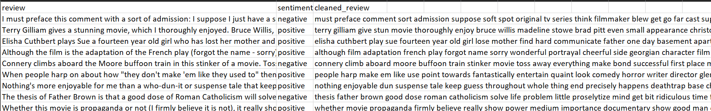
Results:
Cleaned and tokenized data

Slide 12
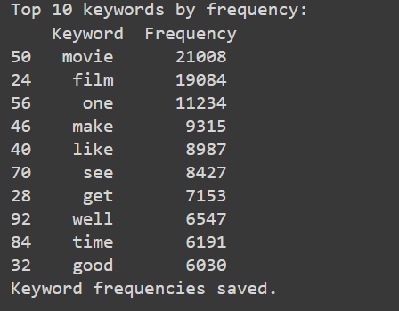
Results:(contd..)
Extracted Keywords

Slide 13
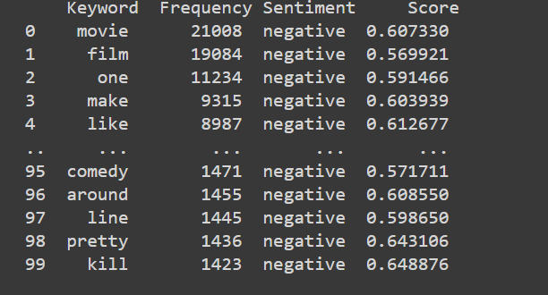
Results:(contd..)
Sentiment Analysis

Slide 14
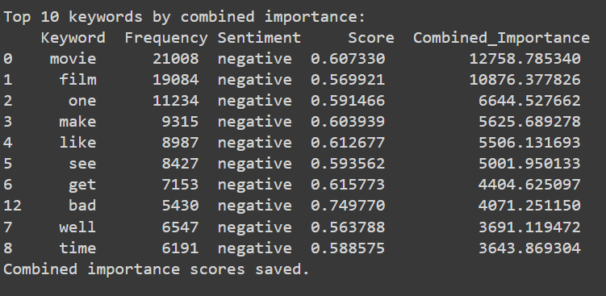
Results:(contd..)
Calculated Importance

Slide 15
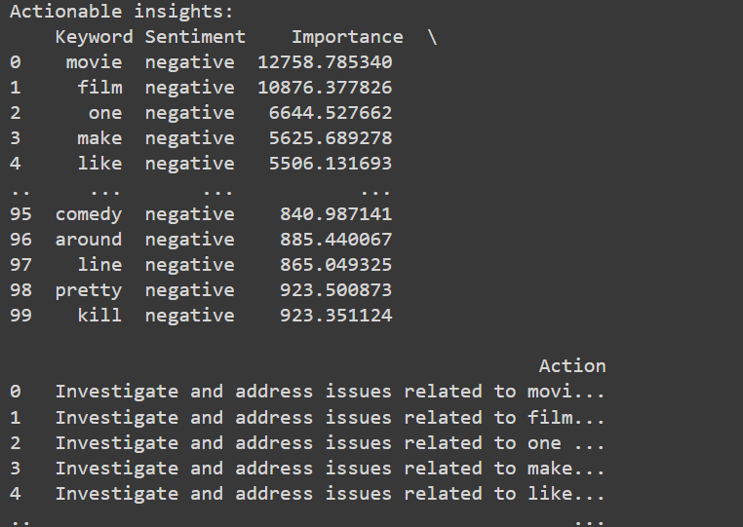
Results:(contd..)
Actionable Insights

Slide 16
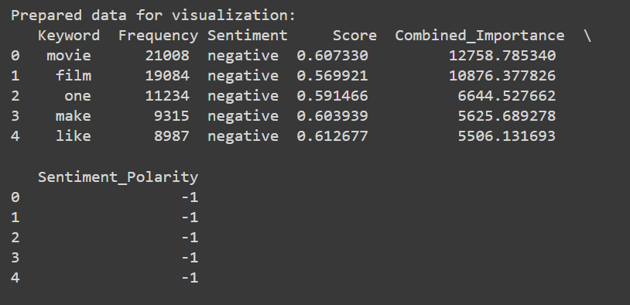
Results:(contd..)
Visual Representation

Slide 17
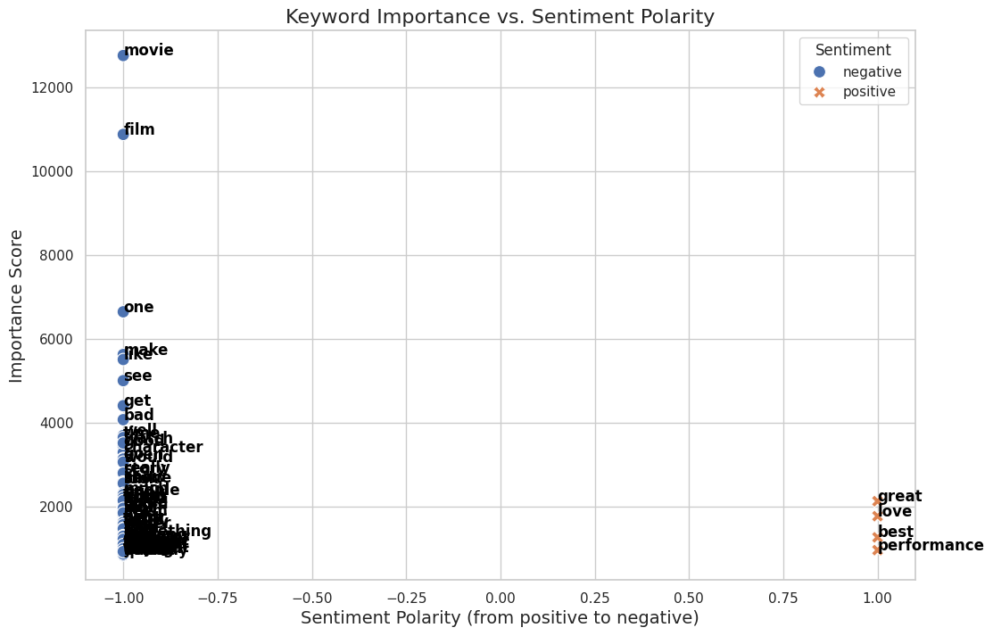
Results:(contd..)
Keyword importance vs sentiment polarity

Slide 18
CONCLUSION
Through the extraction of frequently mentioned keywords, we have identified the primary factors that customers discuss in their feedback.
By determining the sentiment polarity associated with each keyword, we have gained insights into how customers feel about these key factors.
Quantifying the importance of each keyword based on its frequency and sentiment score has allowed us to prioritize the factors that significantly influence customer satisfaction.
The analysis has generated specific, actionable insights that businesses can use to improve customer experience and satisfaction scores effectively.
The scatter plot visualization clearly illustrates the relationship between sentiment polarity and keyword importance, making it easier for stakeholders to understand and act upon the findings.

Slide 19


